Slide 1





Create and Setup a New Project IONIC
Fauzi Sholichin
fauzisholih@gmail.com
+6289673732142
https://www.linkedin.com/in/fauzisho/

Slide 2





Requirement Tools
IDE
Visual Studio
Webstrom Intelj
VIM, ..etc.
Git
A Git GUI (Sourcetree, SmartGit, GitKraken)
GitHub / Gitlab / Bitbucket Account

Slide 3


Setup
Install Nodejs and NPM
Download at https://nodejs.org/en/
Install IONIC
npm install -g ionic

Slide 4
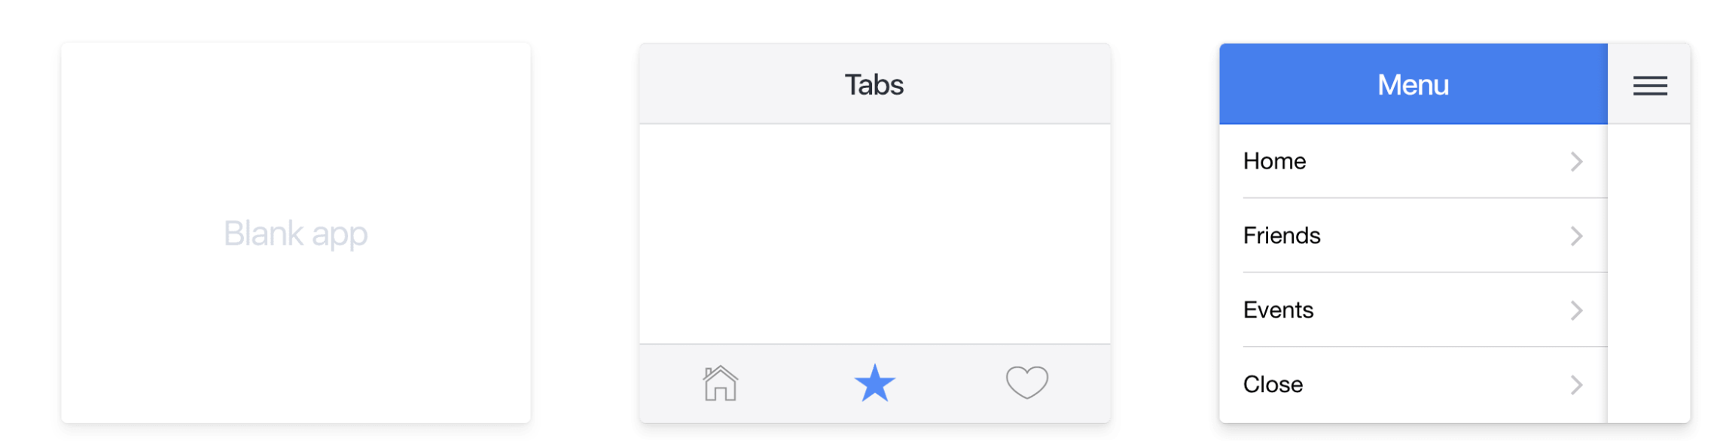
Create a New Project
$ ionic start myApp blank
$ ionic start myApp tabs
$ ionic start myApp sidemenu

Slide 5
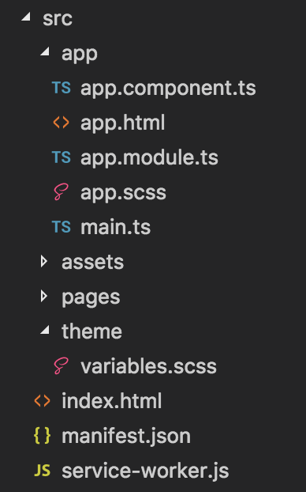
Project Structure
Inside of the src directory we find our code :
index.html -> is the main entry point for the app
app.html -> Here’s the main template for the app
variables.scss -> setting style and theme
assets -> location put your asset
manfiest.json & service-worker.js -> config file for apps

